Slide 1
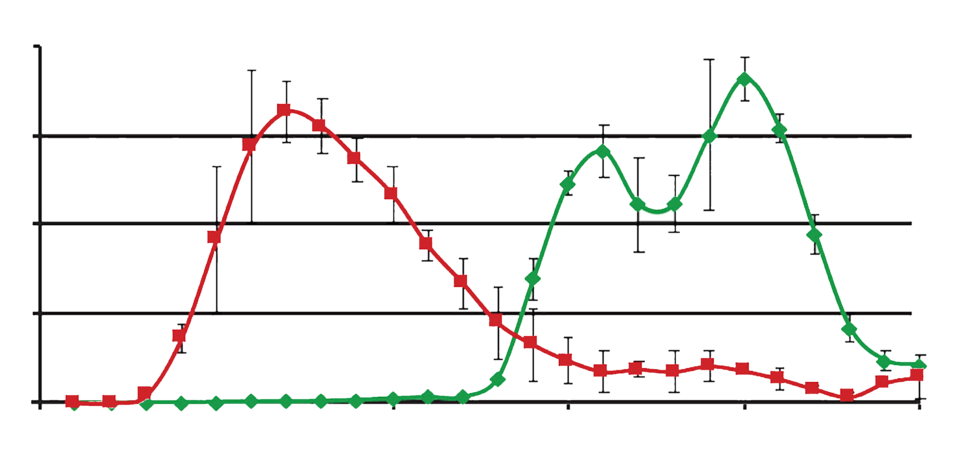
Data Analysis Project 2022
Topic 03: Proteome-wide Screen for RNA-dependent Proteins
Subproject 2: HeLa Cells Synchronized in Mitosis
Supervisor: Dr. Maïwen Caudron-Herger
Tutor: Niklas Engel
Project Presentation
Michel Tarnow, Michèle Bennek, Lennart Müller, Sebastian Rickert;
Date: 19.08.2022
Adapted from: [9]

Slide 2
Why Bother About RNA-dependent Proteins (R-DeeP)?
ATXN2, hnRNPA1, MATR3, TIA-1^{[6]}
Amyotrophic lateral sclerosis (ALS)
TTP, FUS, EWS, TAF15^{[8]}
Frontotemporal Lobar Dementia (FTLD)
TTP^{[6]}
Atherosclerosis
eIF2B^{[7]}
Leukoencephalopathy
(Selection of) RBPs Whose Malfunction Has Been Associated With Human Diseases
RBFOX2^{[6]}
Diabetic cardiomyopathy
SMN^{[8]}
Spinal Muscular Atrophy (SMA)
KHDRBS1^{[1]}, ELAV1^{[2]}, FXR1^{[3]}, UHMK1^{[4]}, PATL2, DUS1L^{[5]}
Cancer
APP^{[7]}
Alzheimer’s Disease
FMRP^{[8]}
Fragile X Syndrome
IRP1^{[7]}
Hyperferritinemia-cataract syndrome
DKC1^{[7]}
Dyskeratosis congenita

Slide 3
What Are R-Deeps, and How Do We Identify Them?
RNase
Proteins whose interactome depends on RNA
Change in RNA-interactions leads to change in data

Slide 4
1. Preliminary Steps
- Data cleaning
- Normalization
- Reproducibility
2. Identification of RNA-dependent Proteins
- Defining selection criteria
- Applying selection criteria
3. Dimension Reduction Analysis
- PCA and UMAP
- Coloring proteins
4. Developing a Linear Regression Model
- Real shift
- Absolute shift
Notes:
In theory - all other things being equal - replicating the same experiment three times should produce three times the same result. This is equivalent to saying that, for a given fraction, the sum of protein amount values across all included proteins of the data set should be equal for all three replicates. However, this is not the case because in reality, experimental conditions aren’t ideal and are subject to various sources of distortion, including naturally occurring statistical fluctuations and limited measurement accuracy. Thus, in order to ensure comparability of our data, it was necessary to perform a column-wise normalization step.

Slide 5
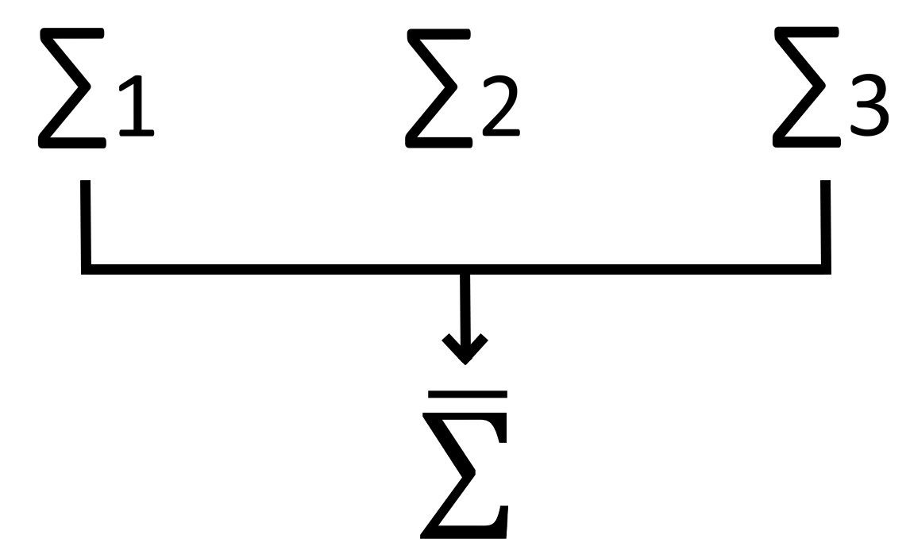
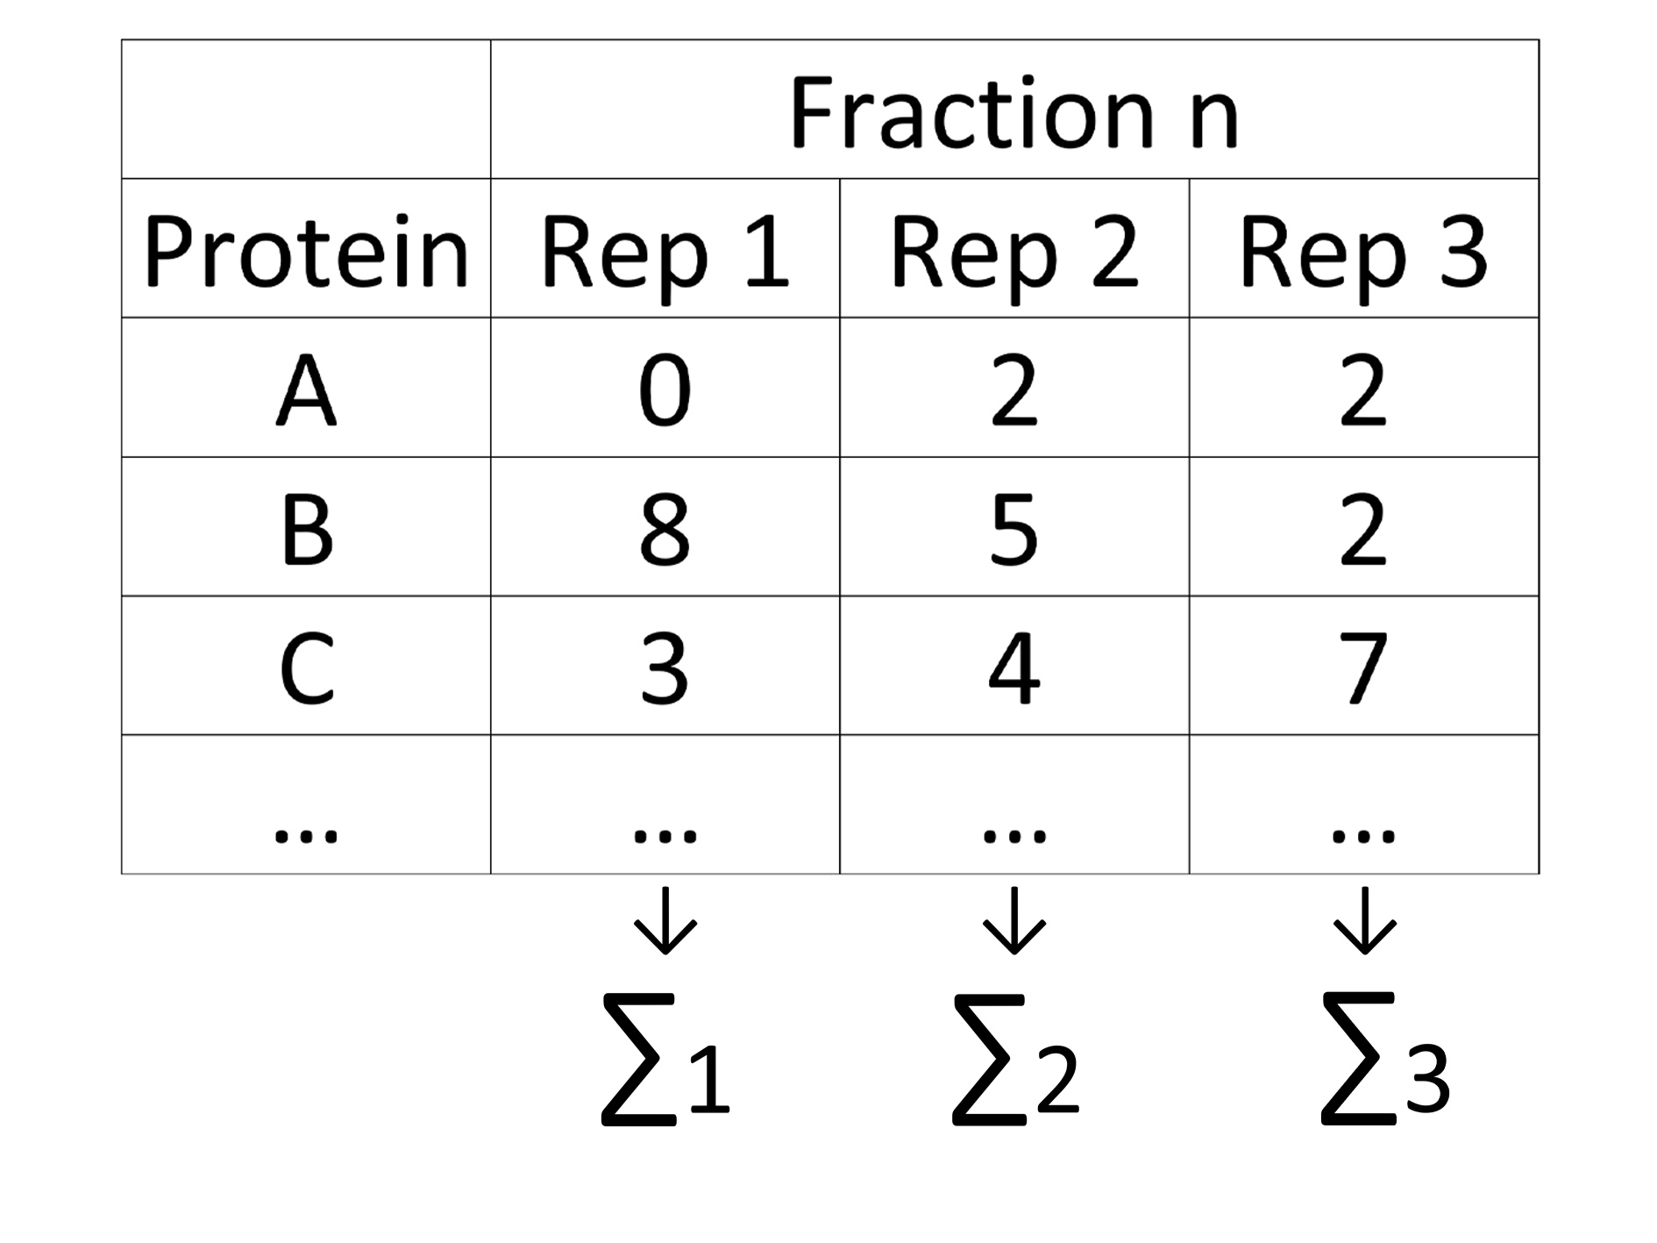
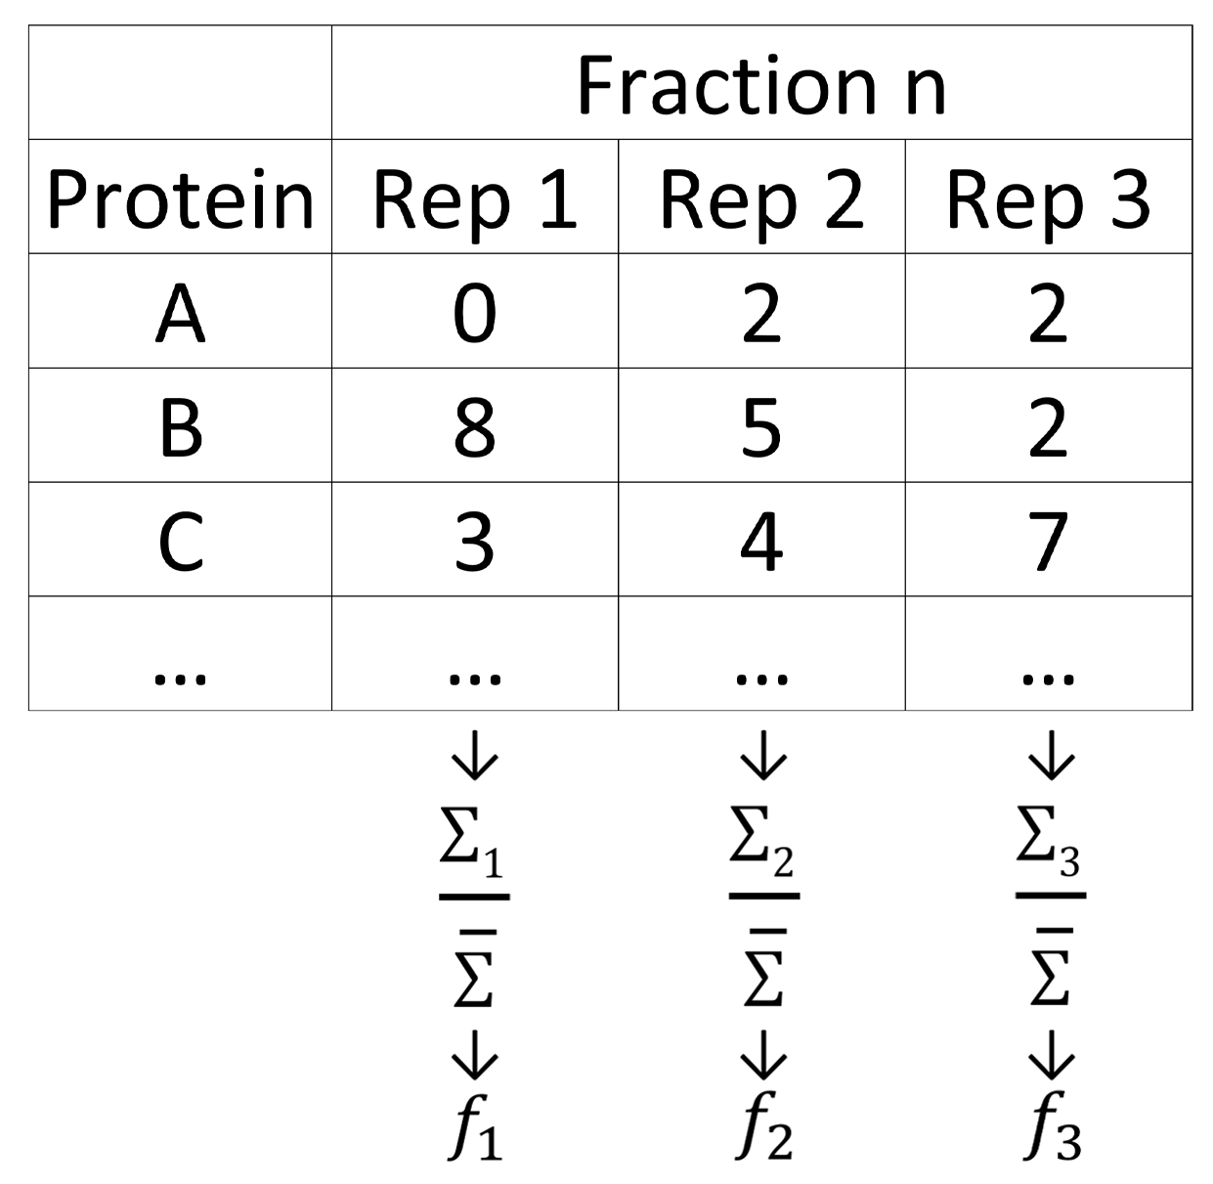
Normalization
1)
2)

Slide 6
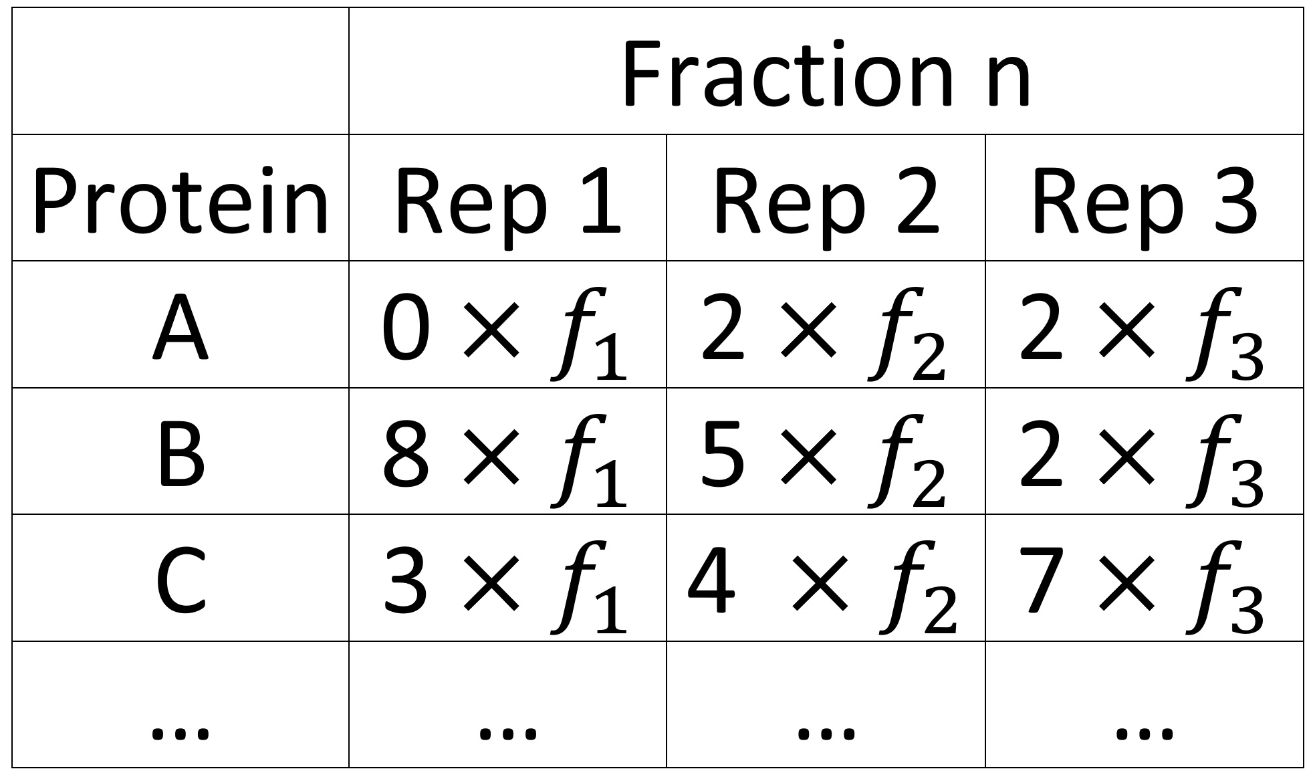
Normalization
Column-wise:
Row-wise:

Slide 7
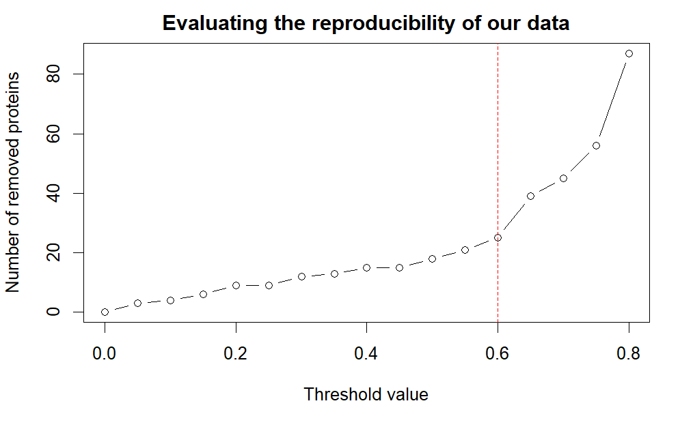
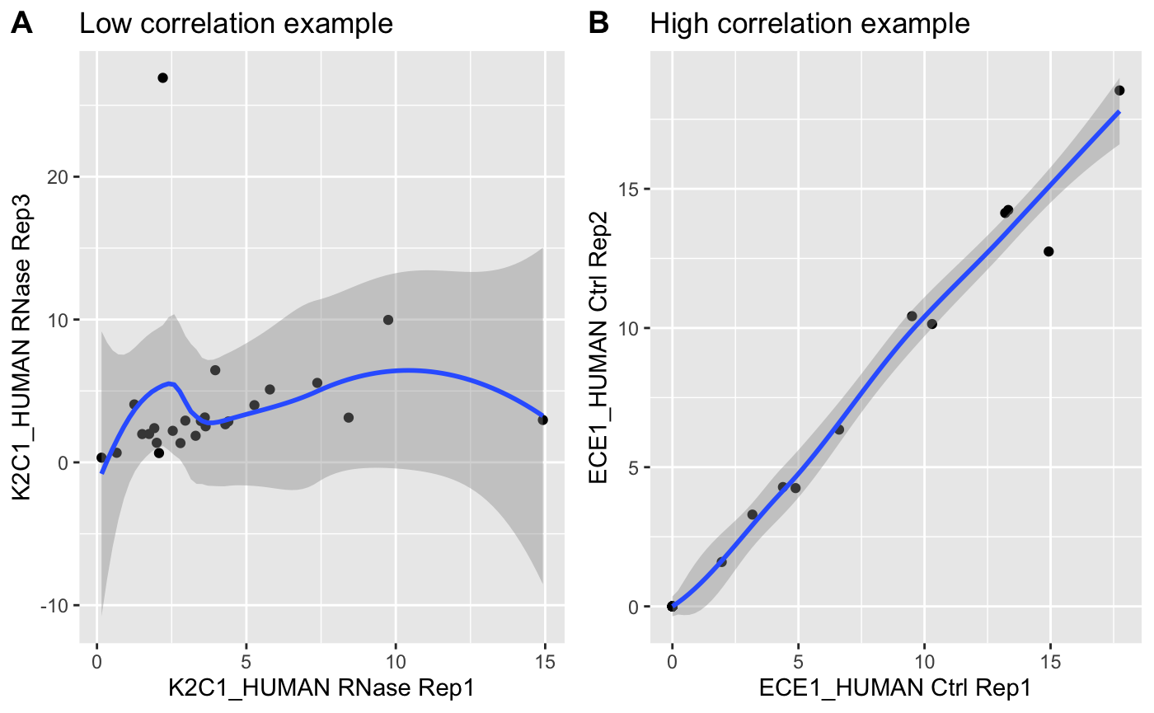
Reproducibility
→ removal of 25 proteins
Notes:
This led to the removal of another 25 proteins from our data set. Therefore, we removed a total of 32 proteins from our data set, which amounts to around 0.5% of all proteins from our native data set.

Slide 8
1. Preliminary Steps
- Data cleaning
- Normalization
- Reproducibility
2. Identification of RNA-dependent Proteins
- Defining selection criteria
- Applying selection criteria
3. Dimension Reduction Analysis
- PCA and UMAP
- Coloring proteins
4. Developing a Linear Regression Model
- Real shift
- Absolute shift
Notes:
In theory - all other things being equal - replicating the same experiment three times should produce three times the same result. This is equivalent to saying that, for a given fraction, the sum of protein amount values across all included proteins of the data set should be equal for all three replicates. However, this is not the case because in reality, experimental conditions aren’t ideal and are subject to various sources of distortion, including naturally occurring statistical fluctuations and limited measurement accuracy. Thus, in order to ensure comparability of our data, it was necessary to perform a column-wise normalization step.

Slide 9
Defining Selection Criteria
1. Selection Criterion:
The position of the global protein amount maximum across all 25 fractions shows an absolute shift between control and RNase greater than one fraction.
and
2. Selection Criterion:
A significant difference in protein amount at the position of the global maximum in control and the respective fraction in RNase.

Slide 10
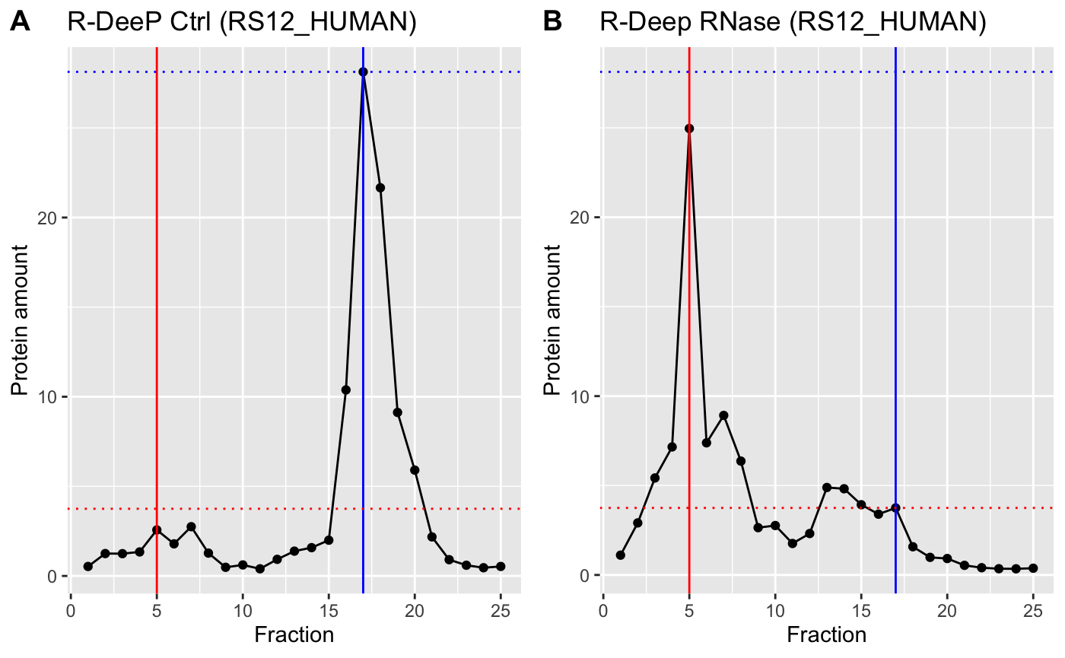
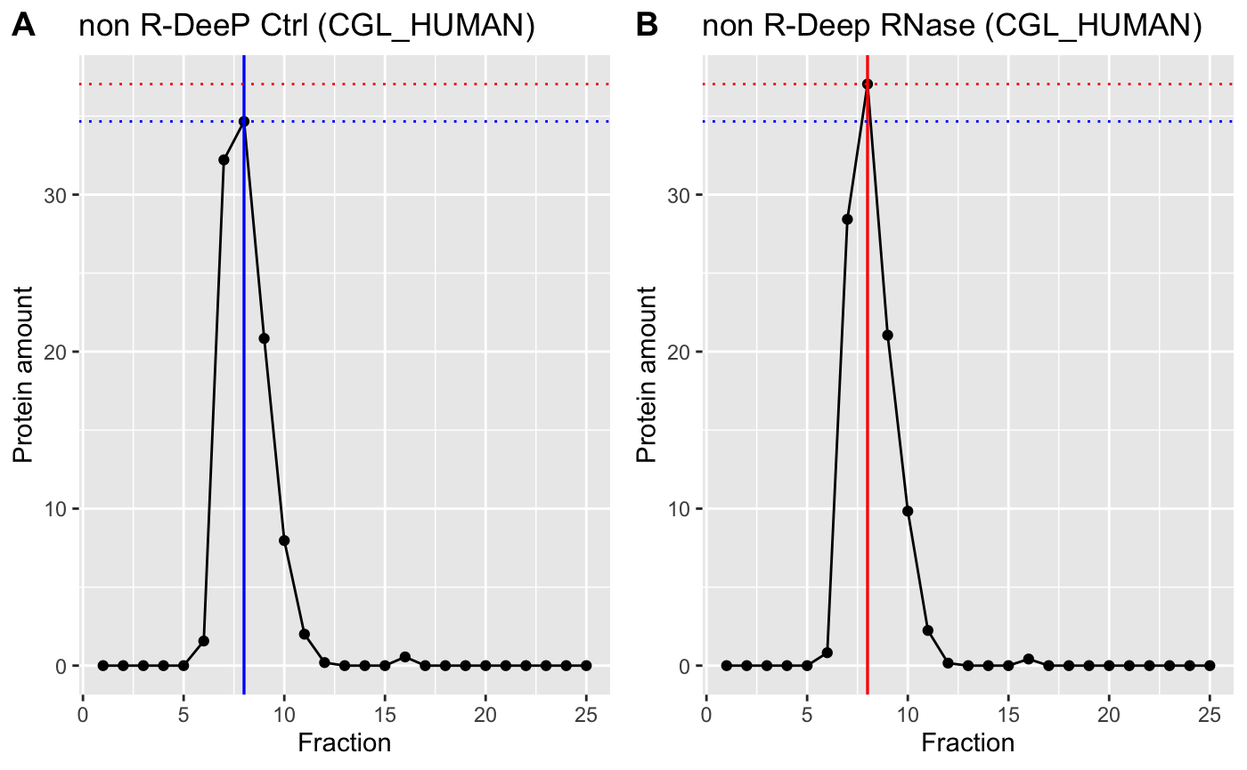
Applying Selection Criteria
R-DeeP:
Non R-DeeP:
■ control
■ RNase
Notes:
Hier ein anderen Plot nehmen ohne lokal maximum dann kann ich daraus eine grafik machen wo shift erklärt wird
Soll ich eine grafik mit tabellen und vektoren machen um zu erklären wie wir die signifikanz berechnet haben?
Info:7127 t-tests performed. P-values were corrected for multiple testing by controlling the false-discovery rate (FDR) according to Benjamini and Hochberg (1995), using the function p.adjust. Therefore, difference in protein amount was regarded as significant if the FDR-corrected p-value p was smaller than the chosen significance level of α = 0.05.

Slide 11
1. Preliminary Steps
- Data cleaning
- Normalization
- Reproducibility
2. Identification of RNA-dependent Proteins
- Defining selection criteria
- Applying selection criteria
3. Dimension Reduction Analysis
- PCA and UMAP
- Coloring proteins
4. Developing a Linear Regression Model
- Real shift
- Absolute shift
Notes:
In theory - all other things being equal - replicating the same experiment three times should produce three times the same result. This is equivalent to saying that, for a given fraction, the sum of protein amount values across all included proteins of the data set should be equal for all three replicates. However, this is not the case because in reality, experimental conditions aren’t ideal and are subject to various sources of distortion, including naturally occurring statistical fluctuations and limited measurement accuracy. Thus, in order to ensure comparability of our data, it was necessary to perform a column-wise normalization step.

Slide 12
Demension Reduction Analysis - PCA and UMAP

Slide 13
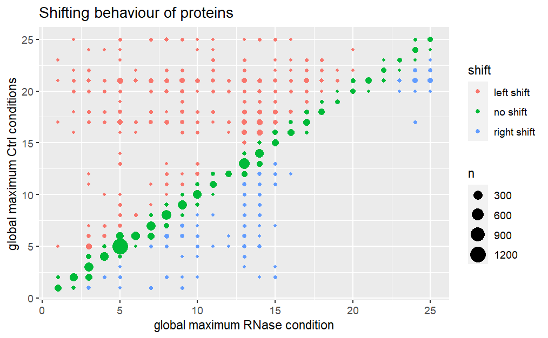
Follow-up Analysis: Distribution of Shifting Behaviour

Slide 14
1. Preliminary Steps
- Data cleaning
- Normalization
- Reproducibility
2. Identification of RNA-dependent Proteins
- Defining selection criteria
- Applying selection criteria
3. Dimension Reduction Analysis
- PCA and UMAP
- Coloring proteins
4. Developing a Linear Regression Model
- Real shift
- Absolute shift
Notes:
In theory - all other things being equal - replicating the same experiment three times should produce three times the same result. This is equivalent to saying that, for a given fraction, the sum of protein amount values across all included proteins of the data set should be equal for all three replicates. However, this is not the case because in reality, experimental conditions aren’t ideal and are subject to various sources of distortion, including naturally occurring statistical fluctuations and limited measurement accuracy. Thus, in order to ensure comparability of our data, it was necessary to perform a column-wise normalization step.

Slide 15
Developing a Linear Regression Model – Real Shift

Slide 16
Developing a Linear Regression Model – Absolute Shift

Slide 17

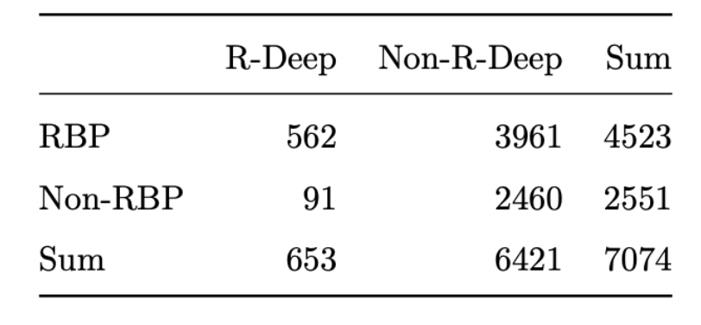
Comparison With Given Databases
RNA-dependent proteins
91 (FP)
Our results:
562 (TP)
2460 (TN)
RNA-independent proteins
3691 (FN)
Recall: 12.4%
Precision: 86.1%

Slide 18
Discussion / Conclusion
Local maxima (computed but not used)
Selection criteria
No smoothing
Mean position for shift
Comparison of R-DeeP and RBP
Development of precise but strict algorithm
→ Identification of R-DeePs
▶
Comparison with data bases
▶
Validation of proposed R-DeeP / RBP candidates
▶
Better understanding of protein and RNA functions in the context of human diseases

Slide 19
References
[1] Bielli, P., Busà, R., Paronetto, M.P., and Sette, C. (2011). The RNA-binding protein Sam68 is a multifunctional player in human cancer. Endocr Relat Cancer 18, R91-r102.
[2] Abdelmohsen, K., and Gorospe, M. (2010). Posttranscriptional regulation of cancer traits by HuR. Wiley Interdiscip Rev RNA 1, 214-229.
[3] Qian, J., Hassanein, M., Hoeksema, M.D., Harris, B.K., Zou, Y., Chen, H., Lu, P., Eisenberg, R., Wang, J., Espinosa, A., et al. (2015). The RNA binding protein FXR1 is a new driver in the 3q26-29 amplicon and predicts poor prognosis in human cancers. Proc Natl Acad Sci U S A 112, 3469-3474.
[4] Feng, X., Ma, D., Zhao, J., Song, Y., Zhu, Y., Zhou, Q., Ma, F., Liu, X., Zhong, M., Liu, Y., et al. (2020). UHMK1 promotes gastric cancer progression through reprogramming nucleotide metabolism. Embo j 39, e102541.
[5] Wang, Z.L., Li, B., Luo, Y.X., Lin, Q., Liu, S.R., Zhang, X.Q., Zhou, H., Yang, J.H., and Qu, L.H. (2018). Comprehensive Genomic Characterization of RNA-Binding Proteins across Human Cancers. Cell Rep 22, 286-298.
[6] Kelaini, S., Chan, C., Cornelius, V.A., and Margariti, A. (2021). RNA-Binding Proteins Hold Key Roles in Function, Dysfunction, and Disease. Biology (Basel) 10.
[7] Gebauer, F., Schwarzl, T., Valcárcel, J., and Hentze, M.W. (2021). RNA-binding proteins in human genetic disease. Nature Reviews Genetics 22, 185-198.
[8] Maziuk, B., Ballance, H.I., and Wolozin, B. (2017). Dysregulation of RNA Binding Protein Aggregation in Neurodegenerative Disorders. Front Mol Neurosci 10, 89.
[9] Caudron-Herger, M., Rusin, S.F., Adamo, M.E., Seiler, J., Schmid, V.K., Barreau, E., Kettenbach, A.N., and Diederichs, S. (2019). R-DeeP: Proteome-wide and Quantitative Identification of RNA-Dependent Proteins by Density Gradient Ultracentrifugation. Mol Cell 75, 184-199.e110.

Slide 20
Goal and Procedure
Goal: Prediction of the absolute and the real shift in position of the global maximum
Set parameters used for predictions
Correlation between mean protein amount values of control and RNase
Split data set 80/20
Perform model training with function lm
Run model with lm.predict

Slide 21
Procedure
Create 50-dimensional mean value data set
Perform principal component analysis using prcomp
Perform Uniform Manifold Approximation and Projection analysis
Color proteins based on
a) RNA-dependance
b) shift

Slide 22
1. Preliminary steps
- Data cleaning - Normalization
- Reproducibility
2. Identification of RNA-dependent proteins
- Defining selection criteria - Applying selection criteria
3. Dimension reduction analysis
- Procedure - Results and their meaning
4. Developing a linear regression model
- Procedure - Results and their meaning
ausgrauen
Notes:
Gliederung: Schlagwörter mit kurzer Erläuterung. Was wurde gemacht

Slide 23
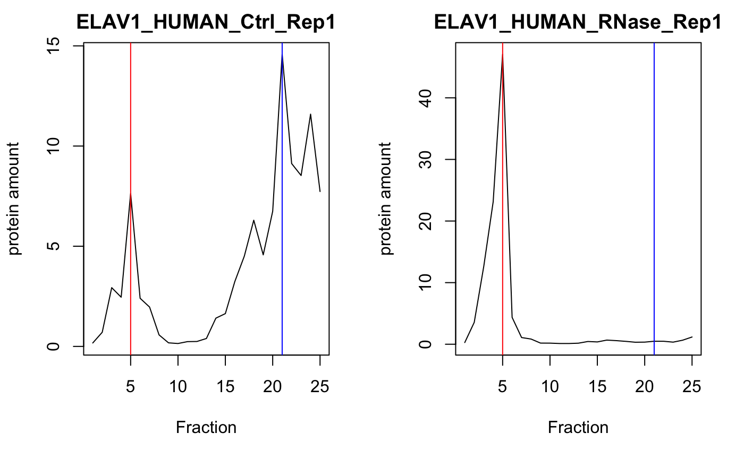
Example Protein: ELAV1
Plotted with R
Notes:
Transition via ELAV1 as an example

